Slide 1

Predicting Accident Severity
Steven Harpham
Data Science Career Track
08/26/2021

Slide 2
Overview
Problem Identification/Data Selection
Data Wrangling
Data Cleaning/Preprossesing
Modeling

Slide 3
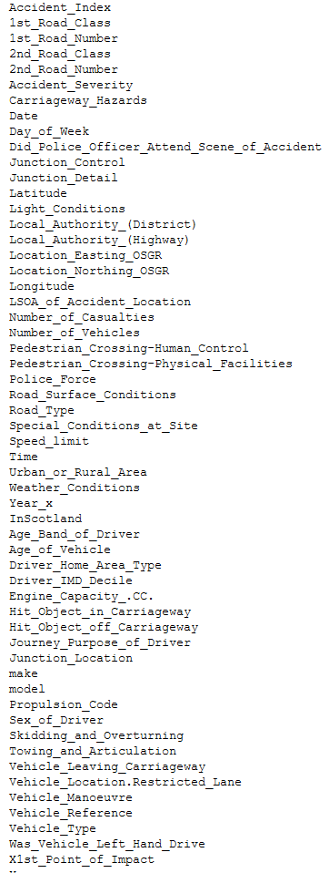
Problem Identification
UK. GOV/ Kaggle Data Source
Dataset – accidents 2004-2016
Contains 57 Features/ ~2 million Rows

Slide 4
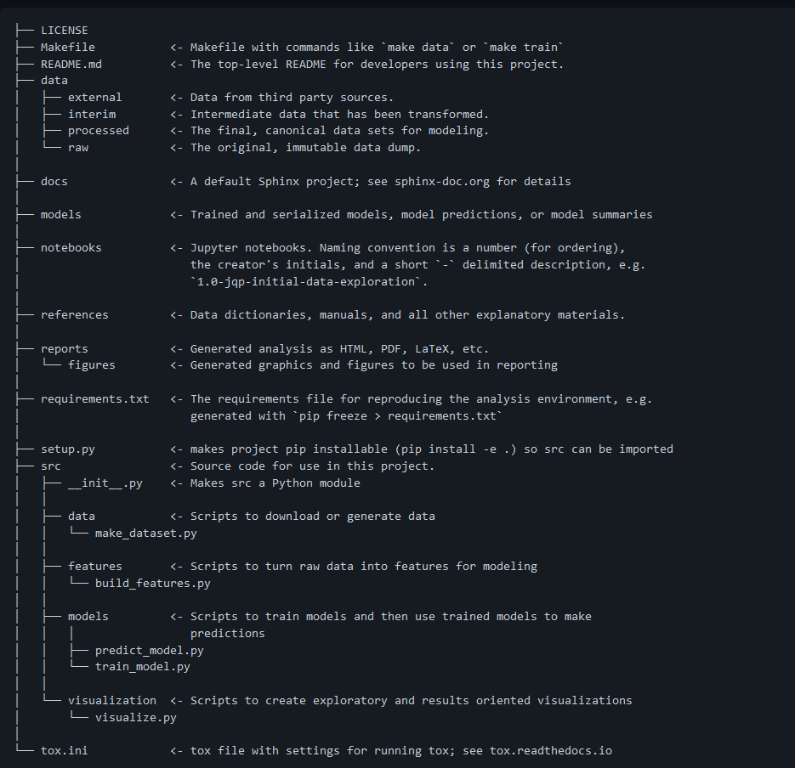
Organization
Virtual Environment
CookieCutter
Github

Slide 5
Wrangling/Cleaning
Dropping Nulls
Impute others
Feature Selection (those present before or during accident)
Drop location based variables

Slide 6
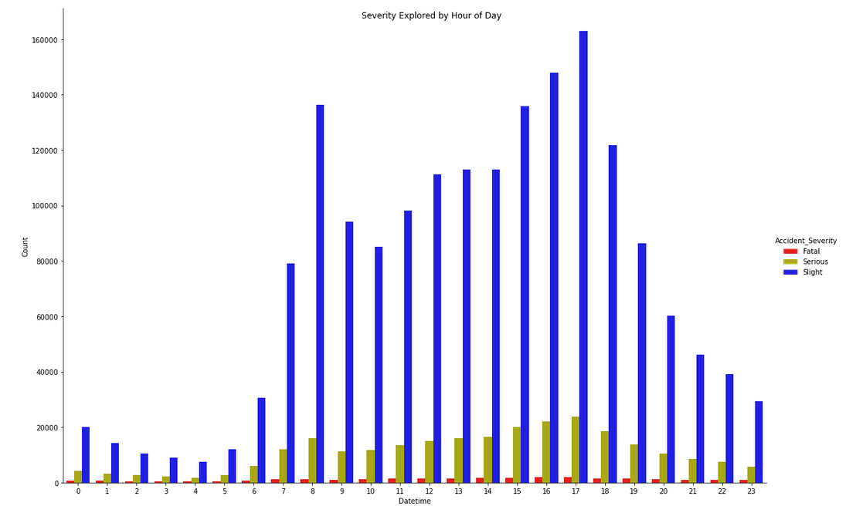
EDA
56 features Vs Severity(3 target levels)
Selected Visualizations

Slide 7
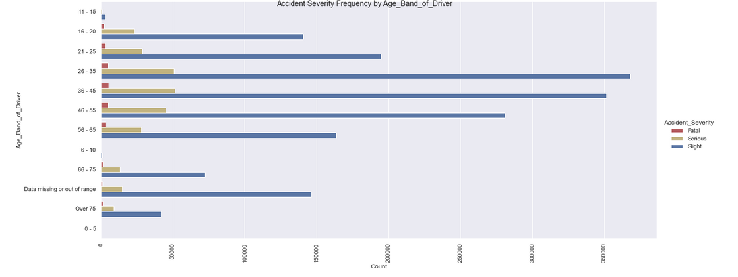
Age Band vs Severity

Slide 8
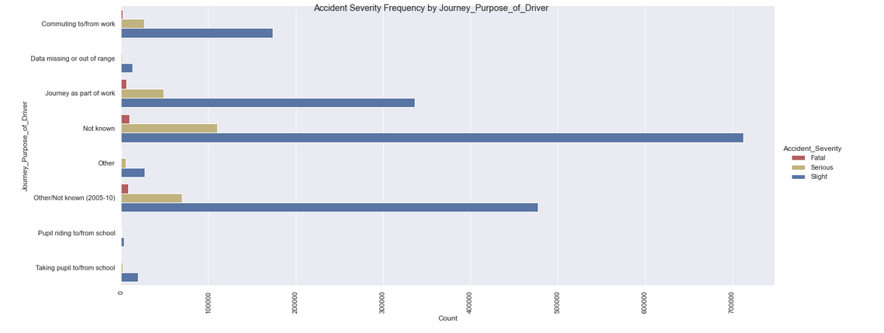
Journey Purpose

Slide 9
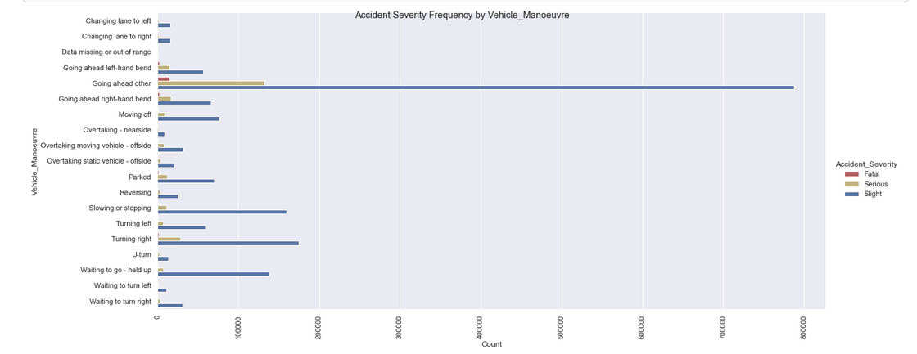
Vehicle Manoeuvre

Slide 10
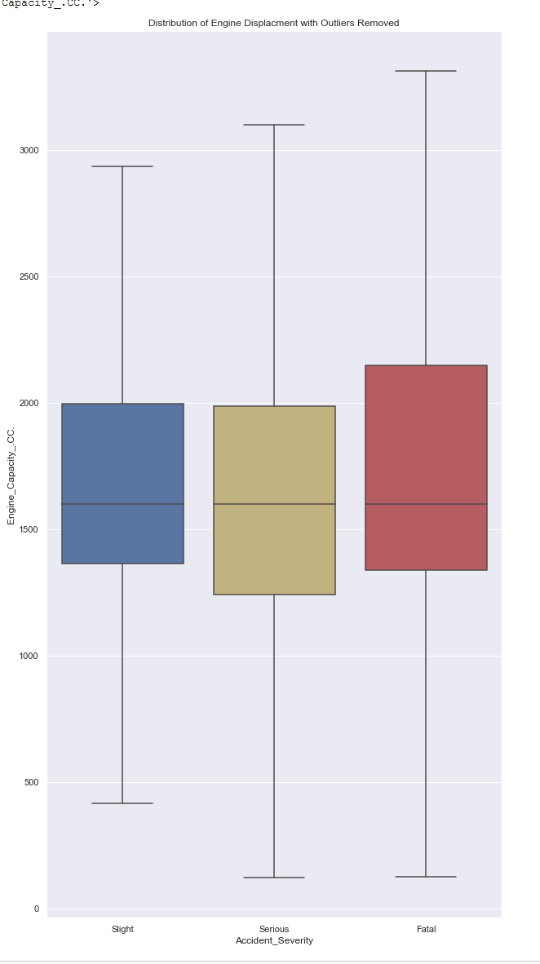
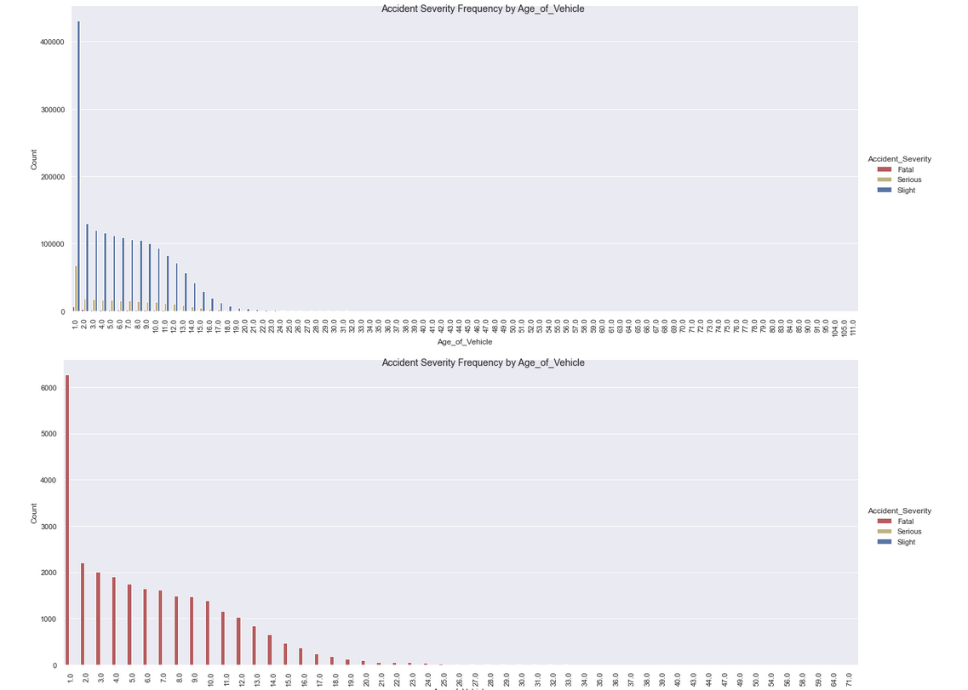
EDA examples

Slide 11
Modeling
Logistic - 2 types (Binary – Fatal/Non-Fatal), and multiclass
Random Forest – Binary and Multiclass
XGBoost - Binary
SMOTE – Synthetic and Multiclass

Slide 12
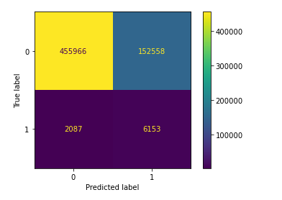
Best Binary Model ( Fatal or Non-Fatal )
Logistic – Fatal or Non-Fatal
 | precision | recall | f1-score | support
Not Fatal | 0.995444 | 0.749298 | 0.855008 | 608524.000000
Fatal | 0.038769 | 0.746723 | 0.073710 | 8240.000000
accuracy | 0.749264

Slide 13
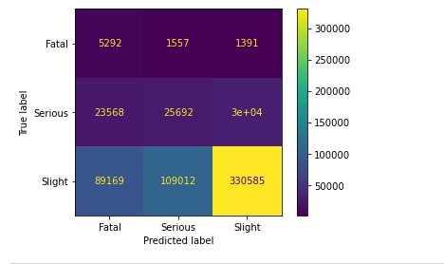
Best Multiclass Model
Logistic w/one vs. rest – Fatal, Severe, Slight
precision recall f1-score support
Fatal 0.044836 0.642233 0.083821 8240.000000
Serious 0.188550 0.322124 0.237868 79758.000000
Slight 0.912024 0.625201 0.741854 528766.000000
accuracy 0.586236

Slide 14
Discussion/Use Cases
In vehicle/live prediction
Suggest a different time to leave etc.
Insurance Company
Call center – Call prioritization
inference about:
Caller vehicle
Caller age
Emergency Response
Call prioritization based in inferred characteristics of caller

Slide 15
Further Research/Ideas
Many other modeling methods to try
Possibly go back and include some location-based data
More cleaning of (unknown/missing) values

